Slide 1
THE STUDY OF CROP YIELD PREDICTION USING VARIOUS MACHINE LEARNING ALGORITHMS
Akhil Edwin(10636297)

Slide 2
Introduction
Crop yield prediction is the process of using various methods, often leveraging technology and data analysis, to estimate the amount of crops that will be harvested from a given agricultural area.
This prediction typically takes into account a range of factors, including weather patterns, soil conditions, historical crop data, and sometimes satellite imagery.
Machine learning algorithms and statistical models are commonly employed to analyze and interpret these factors, enabling farmers and stakeholders to make informed decisions about resource allocation, harvest planning,
overall agricultural management. Accurate crop yield predictions are crucial for optimizing agricultural practices, managing resources efficiently, and ensuring food security.

Slide 3

Background
Crop yield prediction involves aggregating diverse datasets—historical yields, meteorological and soil data, and satellite imagery.
Rigorous preprocessing addresses missing values and standardizes features. Feature engineering identifies key variables influencing yield.
Various machine learning algorithms, including regression models and neural networks, are employed for predictive modeling.
Models are trained on historical data, and their performance is validated for robustness.
The deployment of these models facilitates real-time or seasonal predictions, supporting informed agricultural decisions.

Slide 4
Research problem statement
The research problem addressed in this study centres on the accurate prediction of crop yields in agriculture, employing a diverse set of machine learning algorithms.
The challenge lies in developing models that can effectively leverage historical data, encompassing factors such as average rainfall, pesticide usage, and temperature, to forecast future crop yields reliably.
Agricultural stakeholders face the critical need for advanced predictive tools that navigate the intricate relationships among these variables, offering insights into crop production's dynamic and often unpredictable nature.

Slide 5
objectives
Evaluate and compare performance of diverse machine learning algorithms
1
Conduct thorough data preprocessing, addressing missing values, outliers, and ensuring data consistency.
2
Explore feature engineering techniques to enhance relevance and informativeness of input variables.
3
Train machine learning models on historical data, optimizing hyperparameters for improved accuracy.
4
Investigate ensemble methods or advanced algorithmic configurations to enhance model robustness.
5
Incorporate temporal considerations into models to capture time-dependent trends and variations in crop yield patterns.
6
Use robust performance metrics (e.g., MAE, MSE, R-squared) to comprehensively assess model accuracy.
7
Develop visualizations to communicate model predictions and showcase significant features influencing crop yield.
8

Slide 6

Questions
Which machine learning algorithms demonstrate superior performance in predicting crop yields, and under what conditions?
Explanation: This question aims to identify the most effective algorithm or combination of algorithms for accurate crop yield prediction. Understanding the strengths and limitations of different models will contribute to the selection of an optimal approach based on the dataset's characteristics and the complexity of the problem.
How do various preprocessing techniques impact the accuracy of crop yield prediction models?
Explanation: This question delves into the influence of data preprocessing on model performance. By addressing issues such as missing values and outliers and exploring feature engineering, the study aims to determine the extent to which data quality and preprocessing contribute to the accuracy of crop yield predictions.
What is the temporal pattern in crop yield fluctuations, and how can it be effectively integrated into predictive models?
Explanation: Recognizing the temporal dynamics of crop yields is crucial for accurate predictions. This question seeks to understand the time-dependent trends and variations in crop yield patterns and how they can be incorporated into machine learning models to enhance their predictive capabilities.
To what extent do ensemble methods or advanced algorithmic configurations improve the robustness and generalization of crop yield prediction models?
Explanation: This question explores the potential benefits of employing ensemble methods or advanced algorithmic configurations. Understanding how these techniques contribute to model robustness and generalization will guide the development of more reliable and adaptable crop yield prediction models.

Slide 7
Literature review
The literature review for this crop yield prediction project surveys historical and contemporary approaches.
It explores traditional agricultural methods, delves into machine learning applications, and assesses diverse data sources like remote sensing and weather stations.
The review scrutinizes feature selection and engineering techniques, scrutinizes model validation processes, and considers performance metrics.
Challenges such as data scarcity and model interpretability are examined, alongside emerging technologies for overcoming these hurdles.
Practical implementations in real-world scenarios are also explored, providing a holistic overview that informs the development of an advanced and effective crop yield prediction model for optimized agricultural practices.

Slide 8
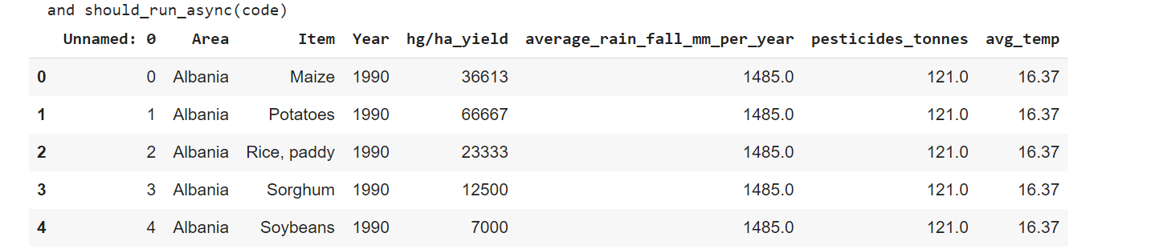
Dataset
Dataset offers a comprehensive glimpse into agricultural dynamics, focusing on crop yield prediction over several years.
Encompassing diverse crops such as maize, potatoes, rice, sorghum, soybeans, and wheat, the dataset provides a multifaceted view of agricultural productivity.
Each entry includes crucial parameters such as the type of crop, the corresponding year, yield per hectare , average annual rainfall, the number of pesticides used, and the average temperature .

Slide 9
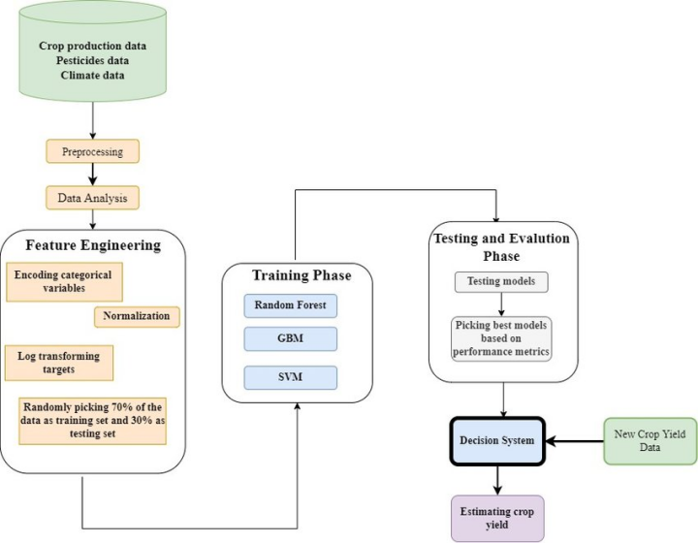
Architecture

Slide 10
Data preprocesing
Data preprocessing for crop yield prediction involves meticulous steps to enhance data quality.
Raw datasets, including historical yields, weather, soil, and satellite imagery, undergo cleaning, handling missing values, and standardization.
Features are carefully selected and engineered to maximize predictive power.
Normalization techniques ensure uniformity across diverse datasets. Outliers and noise are addressed to prevent misinterpretation.

Slide 11
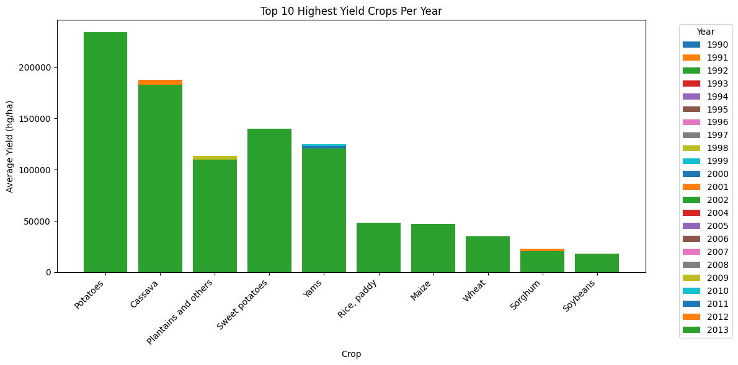
Exploratory data analysis

Slide 12
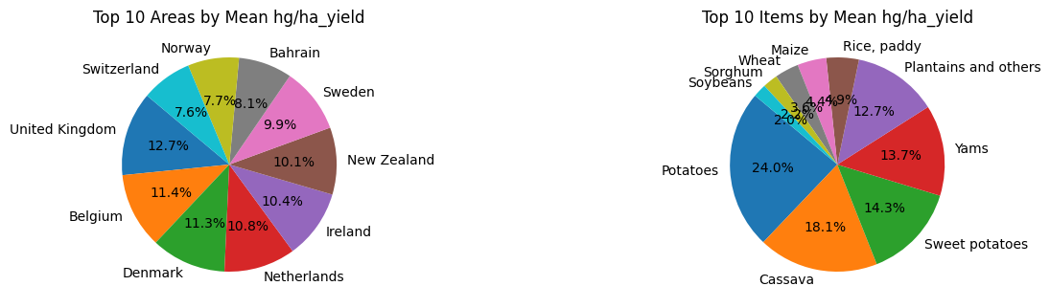
Exploratory data analysis

Slide 13
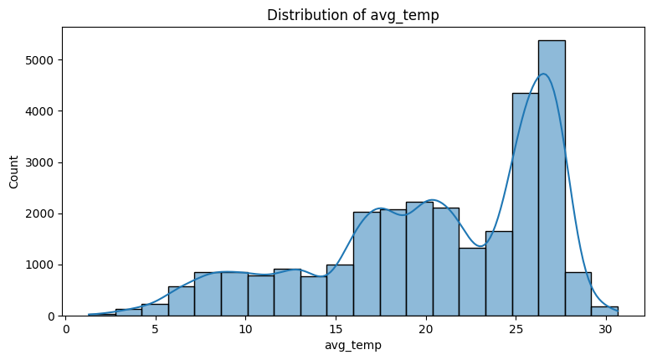
Exploratory data analysis

Slide 14
Modelling
LSTM :
Purpose and Design:
  Crafted for capturing temporal dependencies in sequential data.
  Designed to discern and understand nuanced temporal patterns.
Performance Metric - RMSE:
  Achieved a low RMSE of 1.0598.
  RMSE quantifies average errors between predicted and observed crop yield values.
Prediction Proficiency:
  Demonstrated proficient performance in predicting crop yields.
  Adept at capturing the dataset's temporal intricacies and dependencies.
Sequential Data Handling:
  Proficient in handling sequential data.
  Adaptable to varying time intervals, enhancing prediction effectiveness.
Overall Effectiveness:
  The model's effectiveness in crop yield prediction is highlighted by the low RMSE.
  Combines proficiency in handling sequential data with nuanced temporal pattern recognition.

Slide 15
modelling
CNN Model:
Spatial Analysis Focus:
  Specialized in spatial analysis, particularly in image data.
  Designed to capture spatial hierarchies and patterns within images.
Performance Metric - RMSE:
  Demonstrated an RMSE of 1.1032, slightly higher than the LSTM.
  Indicates reasonably accurate prediction performance.
Feature Arrangement Importance:
  Excelling in tasks where the arrangement of features is crucial.
  Strong capability in capturing spatial hierarchies within images.
Application in Crop Yield Prediction:
  Effective in analyzing aerial or satellite imagery for crop yield prediction.
  Utilizes spatial analysis capabilities to enhance prediction accuracy.
Considerations and Challenges:
  Potential challenges related to computational intensity.
  Considerations for data availability in the context of effective crop yield prediction.

Slide 16
modelling
Random Forest:
Performance Metric - RMSE:
  Notably low RMSE of 0.1550, indicating high predictive accuracy.
  Demonstrates effectiveness in capturing complex relationships within agricultural data.
Ensemble Model:
  Utilizes ensemble learning, aggregating multiple decision trees.
  Leverages collective strength to enhance predictive capabilities.
Versatility in Handling Data:
  Shows versatility in handling diverse variables and potential nonlinear patterns.
  Highlights Random Forest's adaptability to complex agricultural datasets.

Slide 17
modelling
Random Forest:
Performance Metric - RMSE:
Notably low RMSE of 0.1550, indicating high predictive accuracy.
Demonstrates effectiveness in capturing complex relationships within agricultural data.
Ensemble Model:
Utilizes ensemble learning, aggregating multiple decision trees.
Leverages collective strength to enhance predictive capabilities.
Versatility in Handling Data:
Shows versatility in handling diverse variables and potential nonlinear patterns.
Highlights Random Forest's adaptability to complex agricultural datasets.
GBM (Gradient Boosting Machine):
Performance Metric - RMSE:
Achieved an RMSE of 0.4399, indicating robust predictive performance.
Sequentially builds decision trees, correcting errors from previous models.
Ensemble Learning Method:
Similar to Random Forest, GBM is an ensemble learning method.
Excels in capturing intricate relationships and patterns within agricultural data.
Handling Complex Nonlinearities:
Lower RMSE suggests proficiency in handling complex nonlinearities.
GBM's effectiveness in crop yield prediction is attributed to its corrective learning approach.

Slide 18
modelling
SVM (Support Vector Machines):
Performance Metric - RMSE:
Yielded an RMSE of 0.9474, indicating reasonable accuracy.
Recognized for effectiveness in high-dimensional spaces.
Intricate Relationship Handling:
Adept at handling intricate relationships within agricultural datasets.
Suitable for scenarios with numerous dimensions influencing agricultural variables.
Resilience to Overfitting:
While RMSE is higher than ensemble models, SVM demonstrates resilience to overfitting.
SVM's effectiveness lies in capturing complex relationships in agriculture.

Slide 19
modelling
Performance Metric - RMSE:
Demonstrated a low RMSE of 0.2114.
Known for interpretability, making it suitable for understanding variable importance.
Interpretability and Insights:
Operates by recursively partitioning data based on features.
Provides valuable insights into factors influencing crop yields.
Decision Tree:

Slide 20
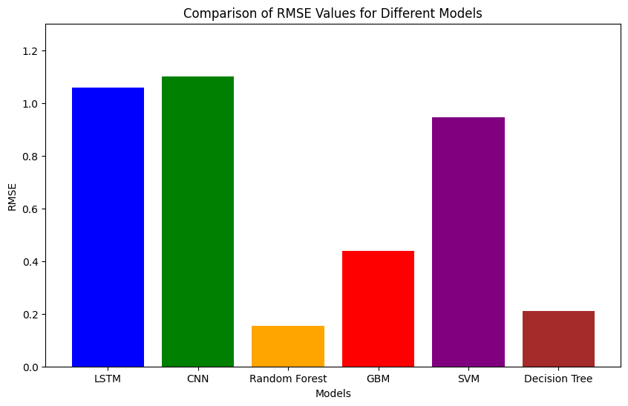
Modelling- Comparison

Slide 21
conclusion
Model Selection Criteria:
Model choice depends on dataset characteristics, variable nature, and available computational resources.
Ensemble Models (Random Forest, GBM):
Showcase predictive capabilities with solid accuracy.
LSTM and CNN:
Demonstrate effectiveness in handling sequential and spatial data, respectively.
SVM and Decision Tree:
Perform well, leveraging strengths in high-dimensional spaces and interpretability.
Role of Evaluation Metrics:
Crucial in guiding model selection and optimization for precise and reliable crop yield predictions in data-driven agriculture.

Slide 22
Future work
Future work in crop yield prediction could explore advanced fusion techniques, integrating diverse data sources such as IoT sensors, hyperspectral imaging, and emerging satellite technologies.
Investigating hybrid models, combining the strengths of machine learning algorithms and physics-based models, holds potential for increased accuracy. Enhanced interpretability through Explainable AI (XAI) methods can build trust in predictive models among stakeholders.
Additionally, addressing scalability challenges and designing user-friendly interfaces for farmers to access and interpret predictions would facilitate widespread adoption.

Slide 23
Thank you

